Slide 1
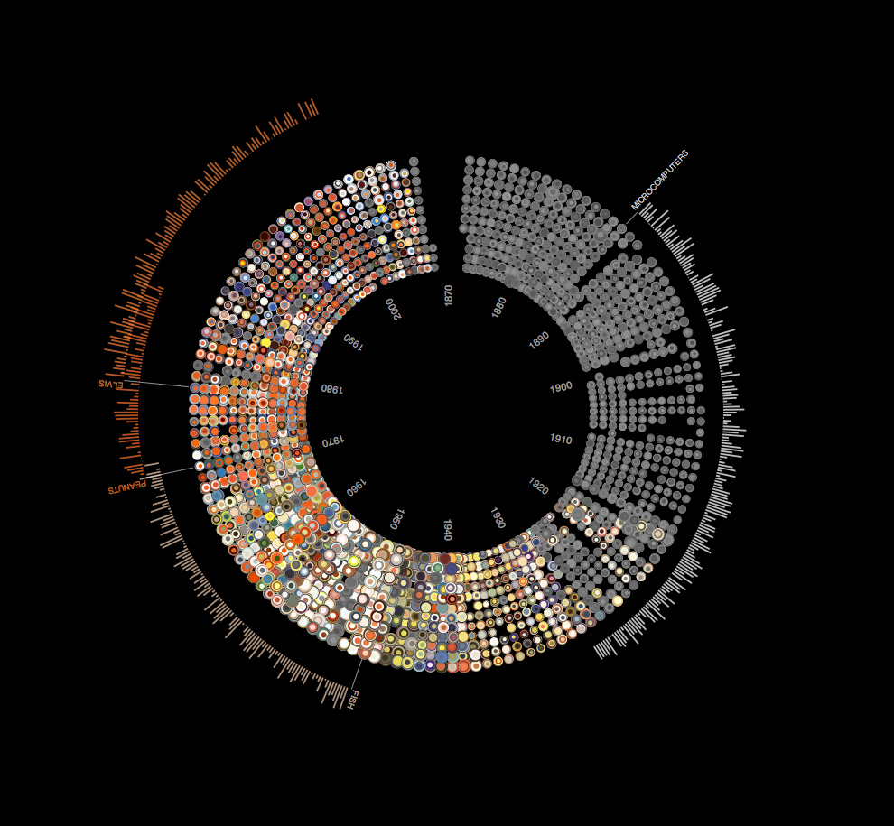

Workshop on Data Science and Machine Learning
Saturday, 22 July 2017

Slide 2
https://goo.gl/BoJ7vz
GitHub Link:
GitHub Link:
Survey Link:
https://goo.gl/7YD9Wn
Use WiFi.HK via CityU

Slide 3
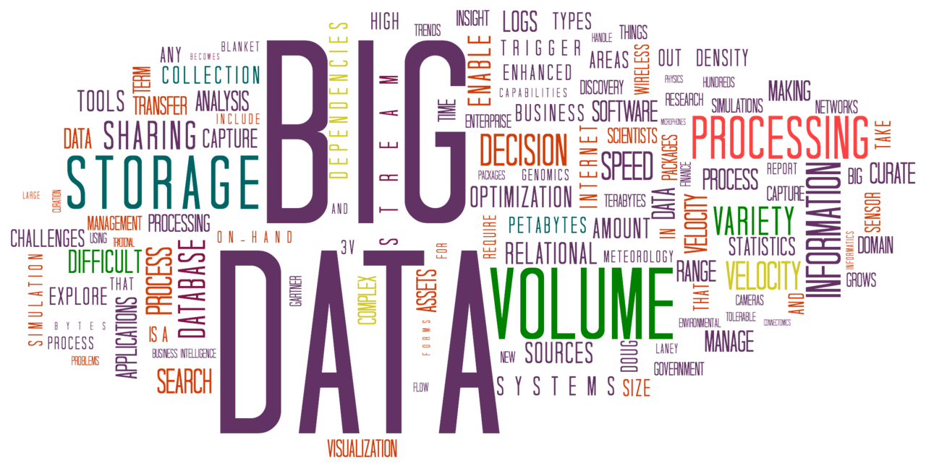

Slide 4
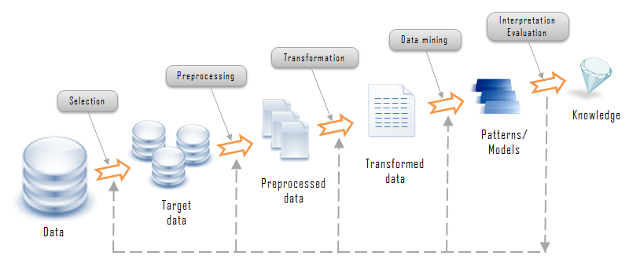
Knowledge Discovery in Databases

Slide 5
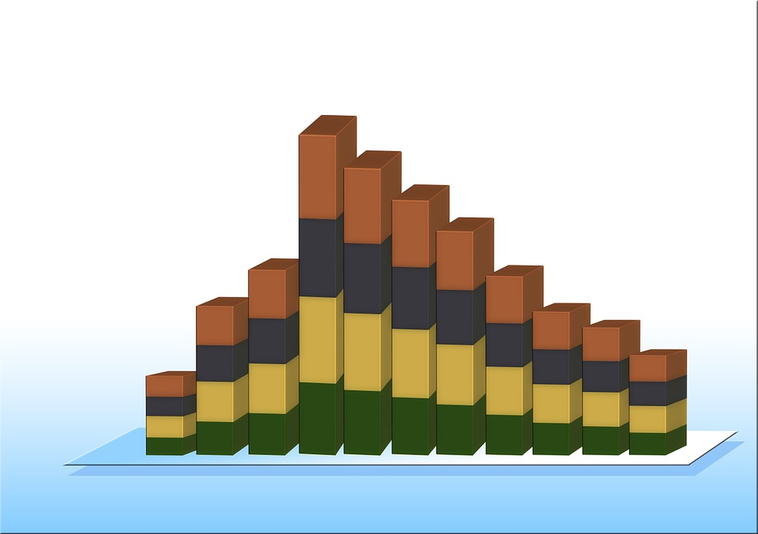
Data Mining (To find novel and useful patterns in data, and predict outcome for future observations)
Applications
Business
Science and Engineering
Medicine
Challenges
Scalability
High dimensionality
Heterogeneous and complex data

Slide 6
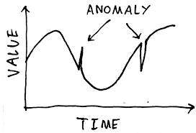
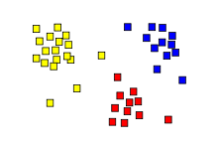
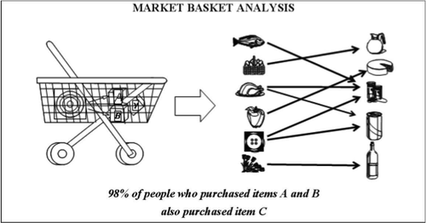
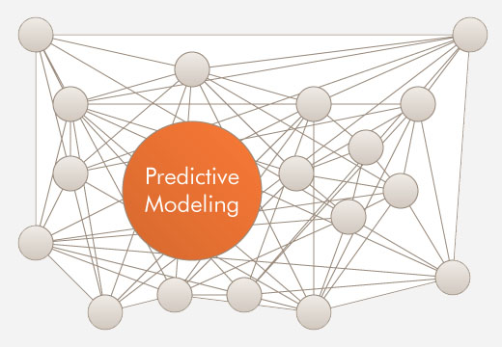
Data Mining Tasks:
Predictive Modeling
Association Analysis
Cluster Analysis
Anomaly detection

Slide 7

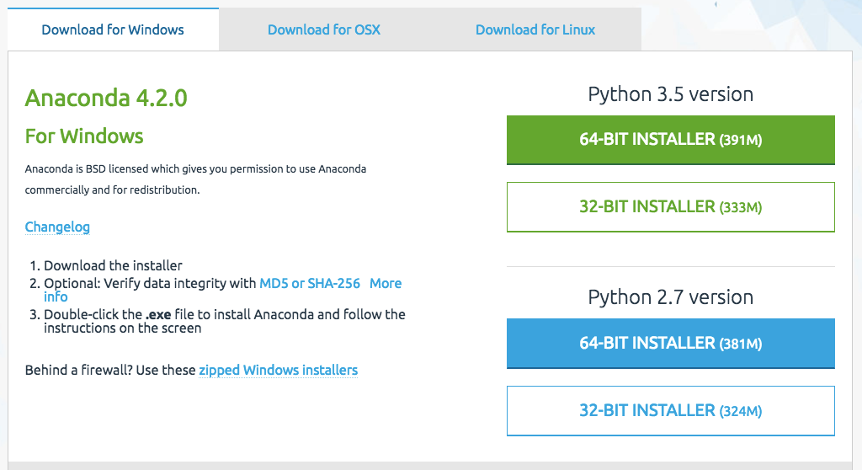
Anaconda Setup
Choose your OS
Choose your OS type (Go to your System Properties to double check)

Slide 8
Data Exploration

Slide 9
What is Data Exploration?
First step in data analysis
Involves summarizing main characteristics of a dataset
Data must be cleaned, organized and empty/null values must be removed
Ultimate Goal: Derive data that is required for your field of study

Slide 10
Data Exploration Libraries
There are several, we will limit our study to:
Geographical Plotting (Choropleth)
NumPy
Pandas
Matplotlib

Slide 11
Geographical Plotting (Choropleth)
What is a choropleth map?
Dictionary def.: a map which uses differences in shading, colouring, or the placing of symbols within predefined areas to indicate the average values of a particular quantity in those areas.

Slide 12
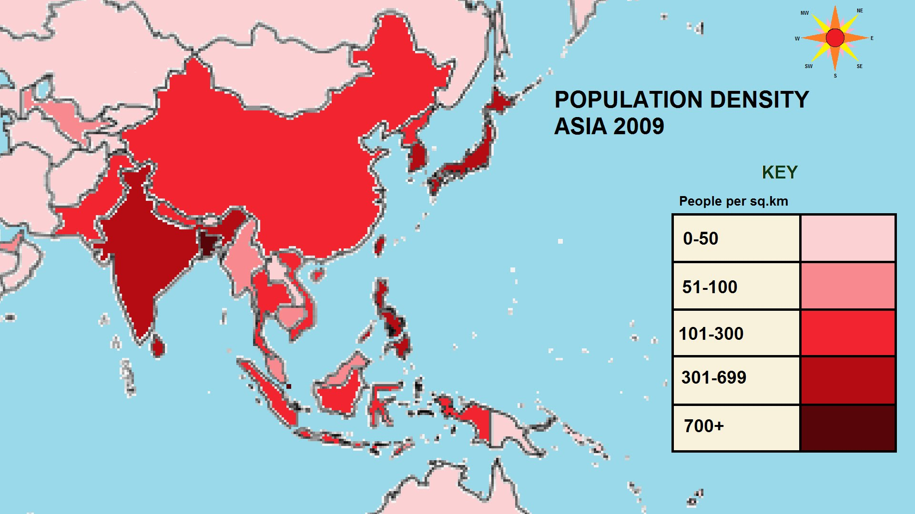
An Example:

Slide 13
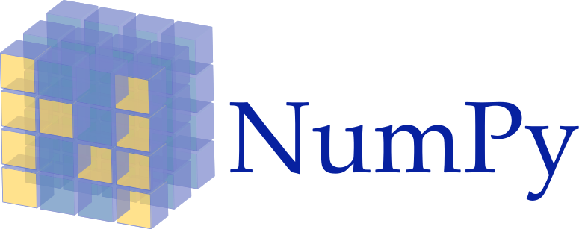
fundamental package for scientific computing with Python that contains:
a powerful N-dimensional array object
sophisticated (broadcasting) functions
tools for integrating C/C++ and Fortran code
useful linear algebra, Fourier transform, and random number capabilities
-from NumPy website

Slide 14
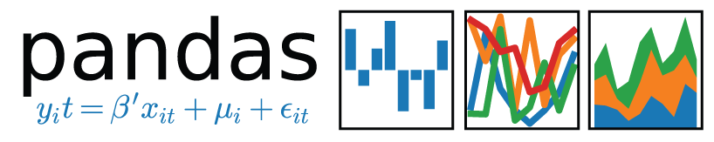
Python package
providing fast, flexible, and expressive data structures
fundamental high-level building block for doing practical, real world data analysis
goal of becoming the most powerful and flexible open source data analysis / manipulation tool

Slide 15

Major Pros of Matplotlib are:
Generally easy to get started for simple plots
Support for custom labels and texts
Great control of every element in a figure
High-quality output in many formats
Very customizable in general

Slide 16
Break time!
~10 minutes
Feel free to ask questions!
GitHub link: https://goo.gl/BoJ7vz

Slide 17
Introduction to Machine Learning
Types of machine learning methods:
Supervised learning a) Classification b) Regression
Unsupervised learning
Reinforcement learning

Slide 18
Supervised learning - Classifications
Given a dataset with training labels, to train a function that outputs a discrete variable (category)
Examples: - Handwritten characters recognition (http://yann.lecun.com/exdb/mnist/) - Malware classification (https://www.kaggle.com/c/malware-classification) - Disease detection (http://www.sciencedirect.com/science/article/pii/S095741741630464X)

Slide 19
Supervised learning - Classifications
Algorithms: - Support vector machine - Logistic regression - Decision trees - K-nearest neighbour - Artificial neural network

Slide 20
Supervised learning - Regression
Find the relationship between the continuous dependent variable y and and the predictor variables x₁, x₂, … , x_{n}
Examples: - House prices prediction - Sales prediction (https://hbr.org/2015/11/a-refresher-on-regression-analysis)

Slide 21
Unsupervised learning
Find structures in a dataset without labels
Examples: - Google News (https://news.google.com/) - Learning social circles in networks (https://www.kaggle.com/c/learning-social-circles)

Slide 22
Reinforcement learning
Getting an agent to act in the world so as to maximize its rewards
Like giving a candy to your kid to reward his behaviors
Examples: - Game playing (https://www.youtube.com/watch?v=MKtNv1UOaZA) - Solfware learning locomotion (https://www.youtube.com/watch?v=itACOKJHYmw)

Slide 23
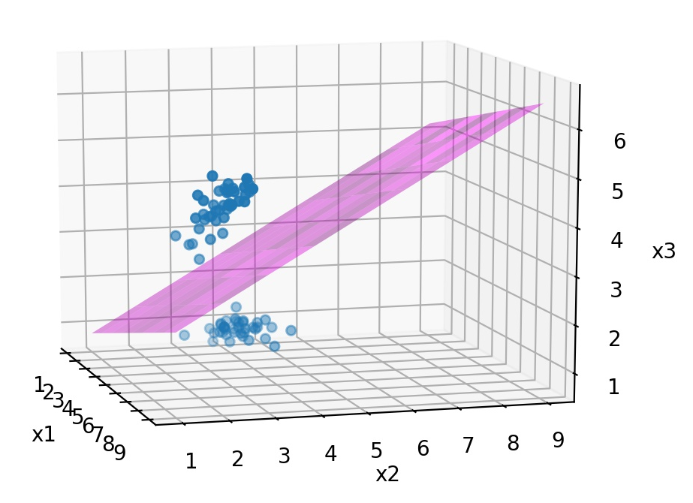
Classification - Support vector machine
Find an hyperplane to separate the data clusters
Also works on linearly inseparable data if we perform ‘kernel tricks’

Slide 24
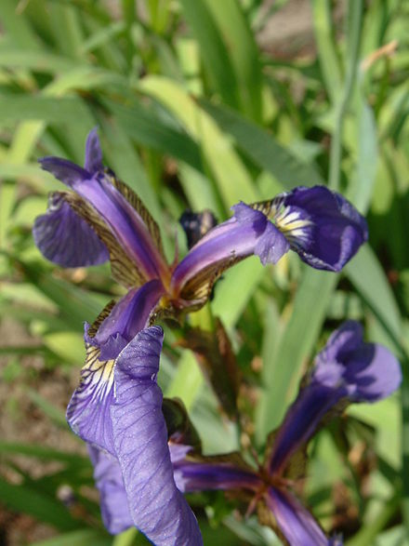
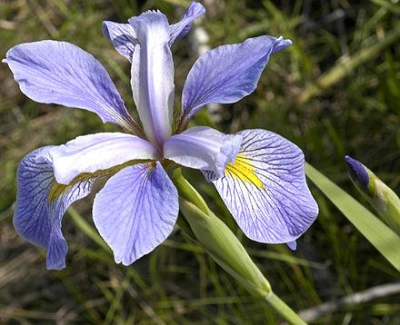
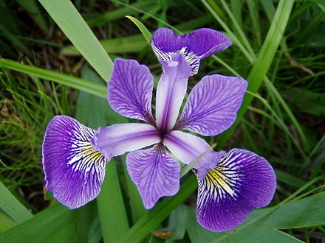
Support vector machine - Practice
Iris dataset
Iris_versicolor
Iris_virginica
Iris_setosa

Slide 25
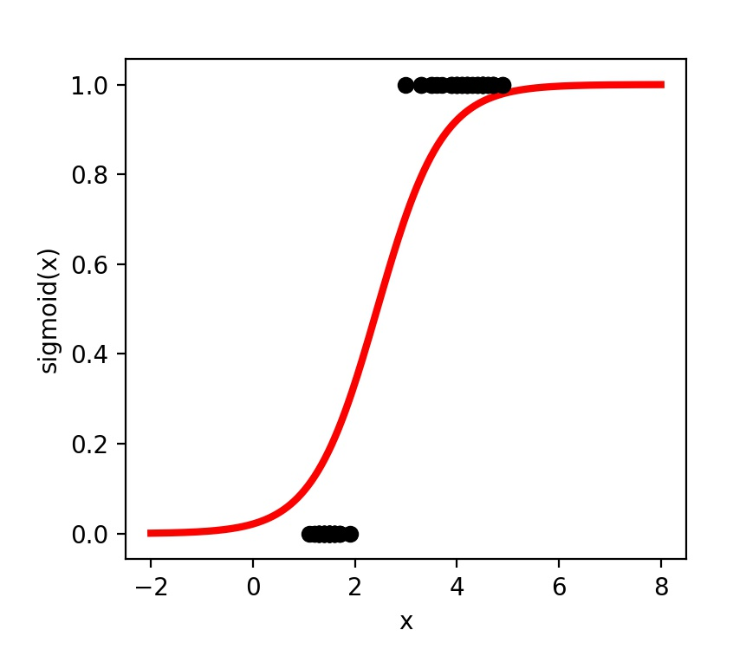
Classification - Logistic regression
Input the feature vector x into the logistic function
Map x into probability p(y|x)
If p(y|x) > 0.5 => y=1, otherwise y=0

Slide 26
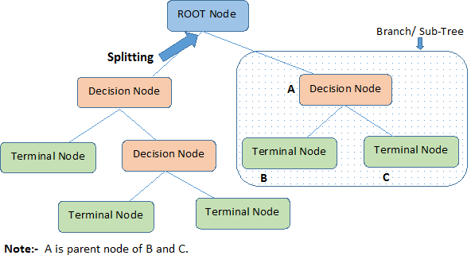
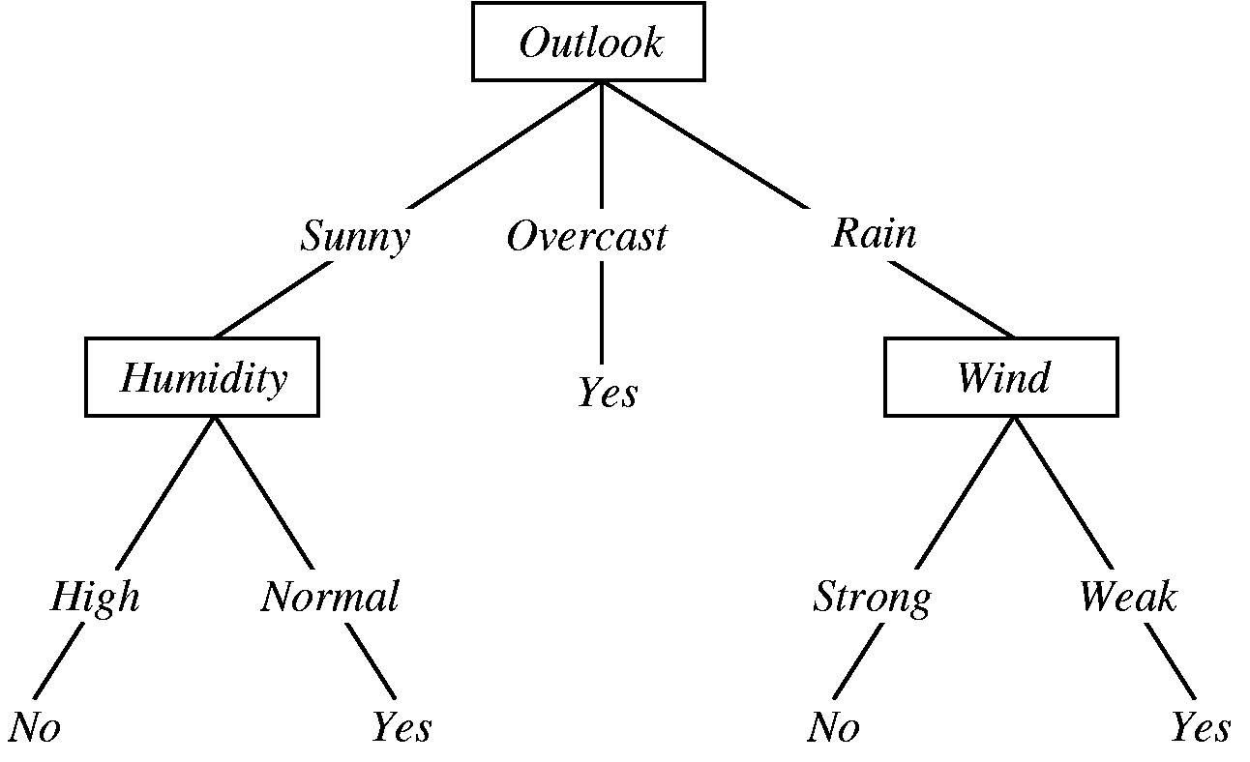
Classification - Decision Trees
Categorical variable
Continuous variable
Terminology
Play Tennis? (example)

Slide 27
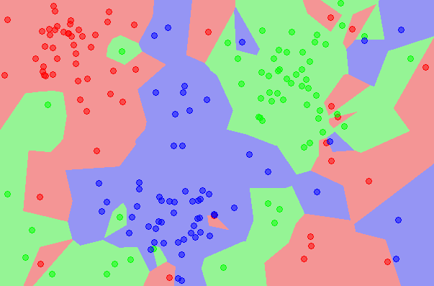
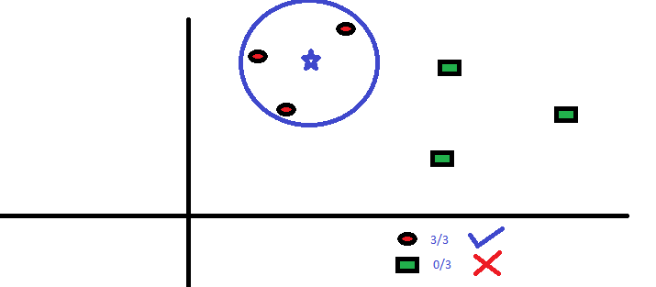
Classification - K Nearest Neighbors
Lazy learning

Slide 28
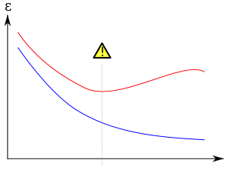
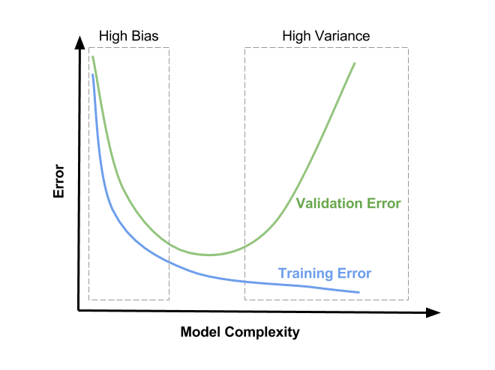
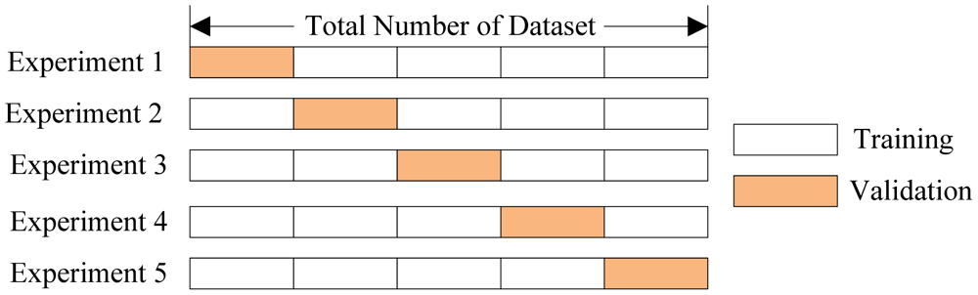
K-fold Cross validation
Underfitting and Overfitting
Bias-Variance trade off (Erroneous assumptions vs Sensitivity to small fluctuations)
Validation set is used for tuning the parameters of a model. Test set is used for performance evaluation.

Slide 29
Applications
Recommender Systems
AlphaGO
Digital Marketing
Image recognition
Speech recognition
Gaming
Delivery logistics

Slide 30
Link for TensorFlow group: https://goo.gl/forms/UT4OH9FkhLVz4Y5y2
That’s all for today folks!
THANK YOU!

